Slide 1


AJEX SCENARIO
EXERCISE BRIEFING
03 NOVEMBER 2026

Slide 2

General Situation
AFP has been conducting its routine operations through an interconnected internal computer network consisting of workstations, servers, and shared information systems. The network supports administrative operations, file storage, and the exchange of operational documents among authorized personnel.
Unknown to the organization, a sophisticated fictional threat group known as APT GHOSTFIRE has identified the organization as a potential target for cyber espionage and information theft.

Slide 3
General Situation
APT GHOSTFIRE intends to gain unauthorized access to the internal network, establish persistence, discover connected systems, compromise additional hosts, obtain access to sensitive information, and ultimately disrupt the organization's operations through a ransomware attack.
The adversary plans to execute a multi-stage cyber operation, beginning with a targeted phishing campaign against one of the organization's personnel.
The Cyber Defense Team must detect, investigate, and contain the intrusion before APT GHOSTFIRE accomplishes its objectives.

Slide 4
Scenario 1 – Initial Access: Phishing Email
Scenario 1 – Attack Sequence
APT GHOSTFIRE sends a phishing email to a designated personnel member containing a malicious attachment named “Annual_Joint_Exe.pdf”.
The personnel downloads and opens the malicious PDF.
The simulated payload creates the directory “C:\Program Files (x64)\Microsoft”
The payload drops an executable named “OneDrive.exe” into the newly created directory.
The payload establishes persistence by creating a scheduled task named “MicrosoftOneDriveUpdate”, configured to execute every 15 minutes.
OneDrive.exe attempts to establish an outbound connection to the attacker's system through TCP port 4433.

Slide 5
Scenario 1 – Initial Access: Phishing Email
Blue Team Expected Findings
The phishing email, including sender/source address and recipient.
The malicious attachment, Annual_Joint_Exe.pdf.
Suspicious directory creation and the dropped OneDrive.exe executable.
Creation and configuration of the MicrosoftOneDriveUpdate scheduled task.
Outbound communication to an unknown IP address through TCP port 4433.
Relevant Wazuh alerts, endpoint events, and supporting logs.

Slide 6
Scenario 2 – Internal Reconnaissance
Attack Sequence
APT GHOSTFIRE continues operating from the compromised workstation.
The adversary explores local directories, system information, and available services.
The adversary locates and reviews List of Users.txt.
Network discovery is conducted to identify active hosts in the internal subnet.
Port scanning identifies open ports on discovered hosts.
Service and version enumeration identifies services such as SSH (TCP/22) and WinRM (TCP/5985).
The adversary records reachable hosts and exposed services for possible further access.

Slide 7
Scenario 2 – Internal Reconnaissance
Blue Team Expected Findings
Network reconnaissance originating from the initially compromised workstation.
Nmap or other host-discovery activity.
Host discovery: one source contacting multiple internal IP addresses.
Port scanning: repeated connection attempts to multiple ports and hosts.
Service/version enumeration and queries to SSH (TCP/22) and WinRM (TCP/5985).
Related firewall records, endpoint telemetry, and Wazuh alerts/logs.

Slide 8
Scenario 3 – Credential Attack & Lateral Movement
Attack Sequence
APT GHOSTFIRE retrieves usernames from List of Users.txt.
Identifies hosts with SSH (TCP/22) exposed during reconnaissance.
Conducts a brute-force attack against an authorized SSH test account.
Successfully establishes an SSH session and gains access to the file server.

Slide 9
Scenario 3 – Credential Attack & Lateral Movement
Blue Team Expected Findings
Multiple failed SSH login attempts against the target host.
Repeated attempts from the same source IP using discovered usernames.
Wazuh brute-force alerts.
Successful SSH login following failed attempts.
Correlated Wazuh alerts and event viewer authentication logs.

Slide 10
Scenario 4 – Discovery & Exfiltration of Exercise Files
Attack Sequence
APT GHOSTFIRE explores accessible directories on the compromised file server.
The adversary discovers a document marked TOP SECRET – EXERCISE ONLY.
The adversary simulates transferring the file to attacker python server..

Slide 11
Scenario 4 – Discovery & Exfiltration of Exercise Files
Blue Team Expected Findings
Identify the classified file accessed and transferred.
Detect file access, staging, and archiving activities.
Identify commands or processes used for exfiltration.
Identify the destination IP and port
Review relevant Wazuh alerts, event viewer logs and network logs.

Slide 12
Scenario 5 – Ransomware Simulation
Attack Sequence
APT GHOSTFIRE downloads a ransomware to the compromised file server
The adversary executes a harmless ransomware simulator
The simulator generates controlled file-impact indicators and a simulated ransom note.

Slide 13
Scenario 4 – Ransomware Simulation
Blue Team Expected Findings
Download or creation of the ransomware test artifact.
Source IP/host, destination host, and URL/domain.
Command line, process tree, parent process, and user responsible for the download.
File hash and download/execution.
Abnormal file modification activity, affected test directory, and ransom-note artifact.
Wazuh alerts, endpoint events, containment actions, and recovery status.

Slide 14
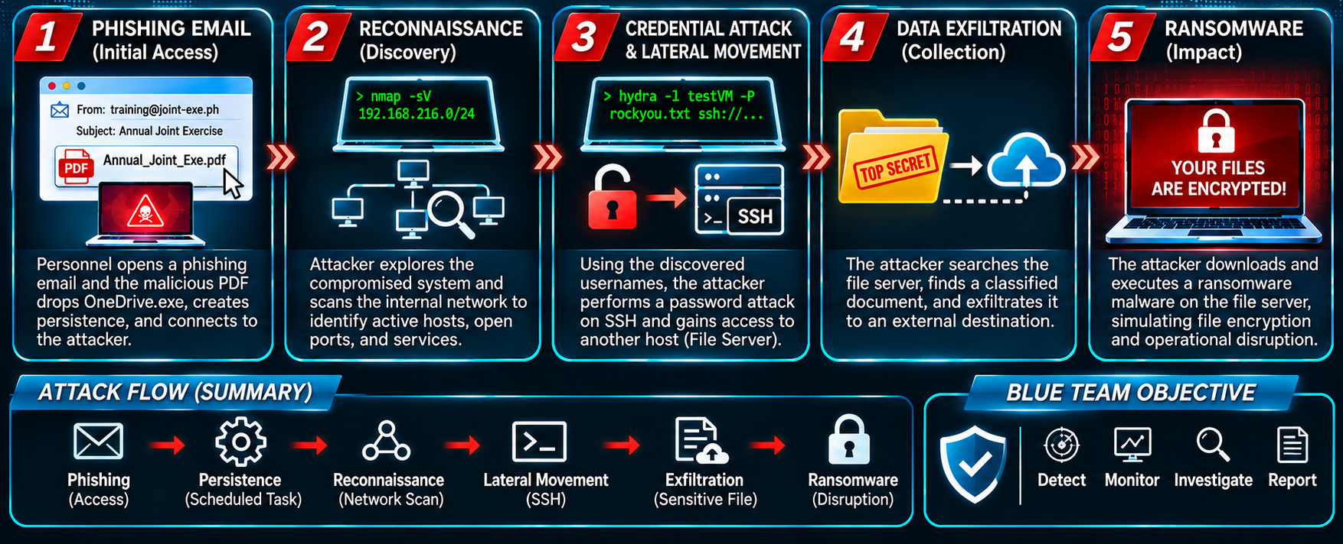
Exercise Scenario Summary

Slide 15

END OF PRESENTATION
ONE · CYBER

